Slide 1
AQA English Language Paper Two
Questions 1-4
Emmett Till Resources
Notes:
A copy of the mark scheme can be found here: https://filestore.aqa.org.uk/resources/english/AQA-87002-SMS.PDF

Slide 2
Do Now:
With your partner, come up with a list of six things that you would expect to find in the human rights act.
Notes:
Image: https://pixabay.com/en/right-human-rights-human-hands-597133/

Slide 3
Emmett Till: Questions 1 and 3
Lesson One
Tuesday, 29 October 2019

Slide 4
Lesson Objectives
AO1
Identify and interpret explicit and implicit information and ideas.
• Select and synthesise evidence from different texts.
AO2
Explain, comment on and analyse how writers use language and structure to achieve effects and influence readers, using relevant subject terminology to support their views
Lesson Outcomes
We will read two sources associated with the case of Emmett Till
We will respond to a Q1 with a focus on the case
We will respond to a Q3 and examine a model response

Slide 5
The Human Rights Act (1998)
Everyone has the right to life.
Everyone has the right to be free from torture and inhuman and degrading treatment or punishment.
Everyone should be free from slavery or forced labour.
Everyone has the right to liberty and security of person.
Everyone has the right to a fair trial, and to be presumed innocent until found guilty, if they are facing a criminal charge.
No one can be found guilty of a crime if there was no law against it when the act was committed.
Everyone has the right to respect for their private and family life, home and correspondence.
Everyone has the right to freedom of thought, conscience and religion.
Everyone has the right to freedom of expression.
Everyone has the right to freedom of peaceful assembly and association.
Everyone has the right to marry and found family.
Everyone has these rights, regardless of their gender, race, language, religion etc.
Now compare your list with the HRA.
How many did you guess?
Are there any that surprise you?
Are there any rights you think are missing?

Slide 6
Sophisticated Subject Terminology Starter:
A noun is a part of speech that denotes a person, animal, place, thing, or idea. The English word noun has its roots in the Latin word “nomen”, which means “name.” Every language has words that are nouns.
Organise the following words into the correct noun category.
Abstract Nouns are nouns denoting an idea, concepts quality, or state.
Concrete Nouns are things that you can experience through your five senses.
TABLE
ME
ENGLAND
LILY
AWESOME
LOVE
MUSIC
OPINION
IT
FAMILY
HERD
PACK
PENCIL
GOOGLE
FAMILY
TRUTH
JEALOUSY
AWESOMENESS
YOU
TIME
CLOCK
SHARON
INTELLIGENCE
FIRE
FIREFIGHTER
RECTANGLE
Collective Nouns are used to show a group of persons, animals or objects.
Pronouns are words that takes the place of a noun.
Proper Nouns: a name used for an individual person, place, or organisation. Spelled with an initial capital letter.
Notes:
If pushed for time, ask students to find two examples for each noun type.

Slide 7
Answers:
CONCRETE
PRONOUN
PROPER
CONCRETE
ADJECTIVE
ABSTRACT
ABSTRACT
ABSTRACT
PRONOUN
COLLECTIVE
COLLECTIVE
COLLECTIVE
CONCRETE
TABLE
ME
ENGLAND
DAFFODIL
AWESOME
LOVE
MUSIC
OPINION
IT
FAMILY
HERD
PACK
PENCIL
GOOGLE
FAMILY
TRUTH
JEALOUSY
AWESOMENESS
YOU
TIME
CLOCK
SHARON
INTELLIGENCE
FIRE
FIREFIGHTER
RECTANGLE
PROPER
COLLECTIVE
ABSTRACT
ABSTRACT
ABSTRACT
PRONOUN
ABSTRACT
CONCRETE
PROPER
ABSTRACT
CONCRETE
CONCRETE
CONCRETE

Slide 8
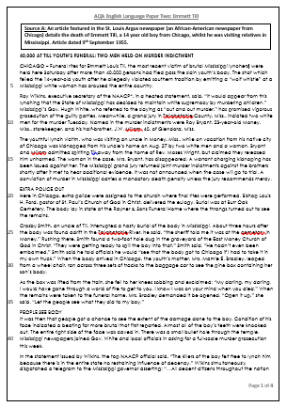
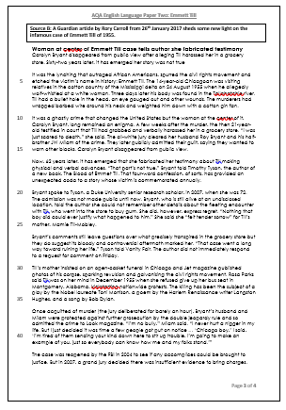
Read Source A
Glue in the sources on a double page (like below), with enough space to make annotations around them.
You each have 4 minutes to read the source you have been given.
Once complete, in your book answer the following questions:
What is the text type?
Who is the audience?
What is the focus of the text?
What language devices are used and for what purpose?
Source A
Source B
Notes:
Image: https://pixabay.com/en/book-isolated-open-book-empty-3057904/

Slide 9
Question One
Re-read Source A, lines 1-21. Select four statements that you believe to be true. Find me the quotation that proves it to be true.
Emmett Till’s funeral was held in Chicago.
Over 400,000 people came to pay their respects.
The Governor promised vigorous protection of those guilty.
Three people kidnapped Till from his Uncle’s home.
e) The case will go to trial on a Tuesday. f) Till was on vacation to Mississippi at the time.
g) Capital punishment was in place at the time of writing in Mississippi. h) The two men were cousins.
Notes:
A, D, F, G

Slide 10
Question One
A - Emmett Till’s funeral was held in Chicago. “CHICAGO – Funeral rites for Emmett Louis Till, the most recent victim of brutal Mississippi lynchers, were held here”
D - Three people kidnapped Till from his Uncle’s home.
“kidnapped from his uncle’s home on Aug. 27 by two white men and a woman”
F - Till was on vacation to Mississippi at the time.
“while on vacation from his native city of Chicago”
G - Capital punishment was in place at the time of writing in Mississippi.
“A conviction of murder in Mississippi carries a mandatory death penalty “

Slide 11
Question Three
This part changes depending on the text. In this case, you should look for anything that shocks you or appeals to your emotions in some way.
“How” – You should focus on the methods that the writer has used.
“Language” – Refer specifically to words, phrases, language features, structural techniques.
Copy out the question. Highlight and annotate the key words. What is the question actually asking you to do?
You now need to refer only to Source A from lines 22 to the end of the extract.
How does the writer use language to shock the reader and appeal to their emotions?
[12 marks]

Slide 12
Example
Q3) How does the writer use language to shock the reader and appeal to their emotions?
Let’s have a go at annotating this quotation together.
“Heated” – Metaphor – Could connote fire and the pain that comes with a burn. Could also connote anger and outrage at the events that have unfolded. Appeals to the reader as we feel the same way.
“State of Mississippi” – Collective Noun – Refers to a collective group with no name. Without a name, there is no one to blame for this atrocity. Appeals to the reader as we are shocked that an official group will not take responsibility.
“in a heated statement, said, “It would appear from this lynching that the State of Mississippi has decided to maintain white supremacy by murdering children.”
Always link back to the question (see italics). Make it clear that you know how to answer the question and are confident in doing so.
“Murdering children” – Juxtaposition of evil and innocence - Infanticide is one of the most horrendous crimes that a human can commit. This choice of words has clearly been chosen for their shock value and it works. The reader feel shock and angered at the injustice.

Slide 13
Write the next two paragraphs
The uncredited writer of Source A is able to shock the reader and appeal to their emotions when he notes that Till’s uncle, “interrupted a hasty burial of the body in Mississippi”. The harsh alliterative sound of the repeated ‘b’ in “burial of the body” reflects the sinister nature of the crime. Similarly, it could also be said that the sound imitates the reader’s disgust. This linguistic choice could have been employed to emphasise the vulgarity of the injuries and allow the reader to clearly and simply see the seriousness of the case. Furthermore, the harsh plosive sound, which is mirrored in the ‘p’ of “Mississippi”, sticks out to the reader when reading aloud. The sounds stick out for dramatic effect but also to show plainly that this crime sticks out from many others due to its harrowing nature. This shocks the reader as we come to understand the disturbing circumstances involved in the case of Emmett Till and his family.
Technique
Quote
Explain
Note that the explanation makes up the majority of my answer. The same should apply to your answer.

Slide 14
Question Three Tips
Key Phrase Box
At first…
Making it seem…
Encouraging the reader to…
In total contrast to this…
This is built on when…
This connotes…
We sense…
When the writer describes…
which expresses…
“A common mistake that students can make is to focus too much on effective words and phrases and ignore other relevant features. When you plan your answer to this question, make sure you analyse sentence forms, language features and punctuation as well” – AQA, 2016
12
Marks
Time | Task | Song
3 Minutes | Find quotations, annotate the techniques and how they link to the question | Radioactive – Imagine Dragons
4 Minutes | Paragraph One | Can’t Stop The Feeling – Justin Timberlake
4 Minutes | Paragraph Two | Things We Lost In The Fire - Bastille
4 Minutes | Paragraph Three | Pumped Up Kicks – Foster The People
Technique
Quote
Explain
Develop
x3
(Develop = Level 4)
Notes:
https://www.youtube.com/watch?v=4U8C_XuE7wc Radioactive
https://www.youtube.com/watch?v=_KAZX8i_RPQ Can’t Stop The Feeling
https://www.youtube.com/watch?v=dYRqIAuY9IQ Things We Lost In The Fire
https://www.youtube.com/watch?v=SDTZ7iX4vTQ Pumped Up Kicks

Slide 15
Hint Key
Why use Emmet Louis Till’s full name?
Can you find a semantic field of violence? Death? Religion?
What anecdotes are used? And how?
What are the connotations of a “pine” box?
Can you find any emotive language?
HINTS
Notes:
Show for low ability sets
Image: https://pixabay.com/en/key-vintage-key-lock-old-antique-2824086/

Slide 16
Plenary – Self Assessment – Q3
Level Four
Your answer is perceptive and detailed.
Level Three
Your answer is clear. You know your stuff!
Level Two
You’re still not quite sure yet. You have the basics, but it’s not 100% clear.
Level One
Your answer is quite simple and lacking in detail.
What are your strengths?
How could your answer be developed?
Clearly and accurately identify the names of the techniques
Use a range of appropriate quotations
Explore the different effects of the writer’s language techniques

Slide 17
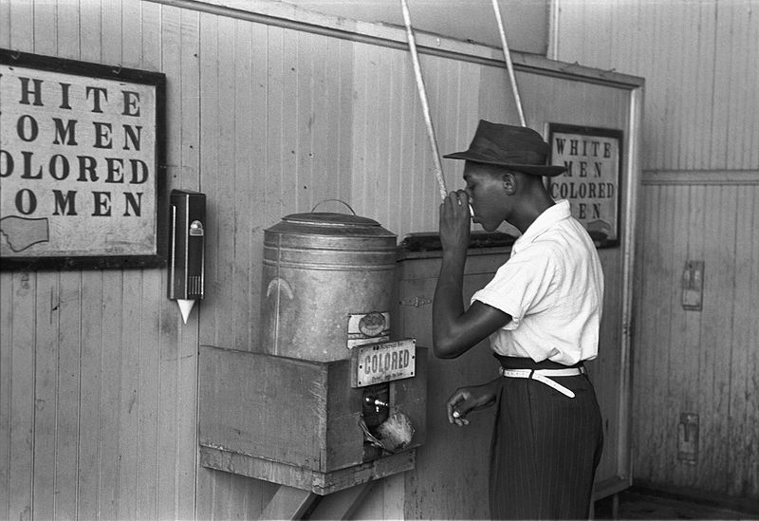
Do Now:
Is it possible to be ‘separate but equal’?
In 1896, an American court allowed segregation (separation of students along racial lines) if it was ‘separate but equal.’
What do you think separate but equal means?
Notes:
Image: https://commons.wikimedia.org/wiki/File:%22Colored%22_drinking_fountain_from_mid-20th_century_with_african-american_drinking.jpg

Slide 18
Emmett Till: Questions 1 and 2
Lesson Two
Tuesday, 29 October 2019

Slide 19
Lesson Objectives
AO1
Identify and interpret explicit and implicit information and ideas.
• Select and synthesise evidence from different texts.
Lesson Outcomes
We will read two sources associated with the case of Emmett Till
We will respond to a Q1 with a focus on the case as told from a 2017 perspective
We will respond to a Q2 and examine a model response

Slide 20
Homework: Due Friday
Create a subject terminology glossary somewhere that is easily accessible in your books. This should include key linguistic and structural words and phrases, their definitions and one example of the technique in use. E.g.:
Metaphor | A figure of speech in which a word or phrase is applied to an object or action to which it is not literally applicable. | “You are the thorn in my side.”
Don’t just copy definitions from the internet. The task is pointless if you do not understand the terms.
Notes:
Image: https://pixabay.com/en/search-to-find-internet-1013910/

Slide 21
Sophisticated Subject Terminology Starter:
The verb signals an action, an occurrence, or a state of being. Whether mental, physical, or mechanical, verbs always express activity.
Organise the following words into the correct verb category.
Dynamic Verbs are verbs that express action.
Modal Verbs are used to express: ability, possibility, permission or obligation.
RUN
BREAK DOWN
SHUT
TEAR UP
HEAR
COULD
AM
STAND UP
DOESN’T
FEEL
TYPE
RECOGNISE
ARE
GOOGLE
BREAK OUT
ASSIGN
MIGHT
APPRECIATE
SMELL
CHAT
ATTEND
UNDERSTAND
LEARN
IS
HAVE
TAKE OFF
SHALL
CAN
Stative Verbs express a state rather than an action.
Imperative Verbs create an imperative sentence i.e. a sentence that gives an order.
Auxiliary Verbs are used together with a main verb to show the verb’s tense or to form a negative or question.
Phrasal Verbs combination of words that when used together, usually take on a different meaning to that of the original verb.
Notes:
If pushed for time, ask students to find two examples for each verb type.

Slide 22
Answers
RUN
BREAK DOWN
SHUT
TEAR UP
HEAR
COULD
AM
STAND UP
DOESN’T
FEEL
TYPE
RECOGNISE
ARE
GOOGLE
DYNAMIC
PHRASAL
DYNAMIC
PHRASAL
STATIVE
MODAL
AUXILIARY
PHRASAL
MODAL
STATIVE
DYNAMIC
STATIVE
AUXILIARY
DYNAMIC
BREAK OUT
ASSIGN
MIGHT
APPRECIATE
SMELL
CHAT
ATTEND
UNDERSTAND
LEARN
IS
HAVE
TAKE OFF
SHALL
CAN
PHRASAL
DYNAMIC
MODAL
STATIVE
STATIVE
DYNAMIC
DYNAMIC
STATIVE
DYNAMIC
AUXILIARY
AUXILIARY
PHRASAL
MODAL
MODAL
EXT: What do you notice about imperative verbs?

Slide 23
Question One
Read the first part of Source B, from lines 1 to 15.
Choose four statements below which are TRUE. Find me the quotation that proves it to be true.
Carolyn Bryant accused Till of harassment.
This case sparked the civil rights movement.
Till’s body was found in a Tallahatchie lake.
Till’s death changed the United States.
e) Roy Bryant and JW Milam walked free even though they admitted their guilt.
f) Carolyn Bryant was only 12 at the time.
g) Mississippi was known as the coal county.
h) Till was found dead on the 24 august 1955.
Notes:
A, B, D, E

Slide 24
Question One
Carolyn Bryant accused Till of harassment.
This case sparked the civil rights movement.
d) Till’s death changed the United States.
e) Roy Bryant and JW Milam walked free even though they admitted their guilt.
“Carolyn Bryant disappeared from public view after alleging Till harassed her”
“It was the lynching that outraged African Americans, spurred the civil rights movement”
“It was a ghastly crime that changed the United States”
“The all-white jury cleared her husband Roy Bryant and his half-brother JW Milam of the crime. They later publicly admitted their guilt”

Slide 25
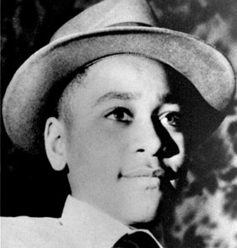
Now read the whole of source B
You each have 4 minutes to read the source you have been given.
Once complete, in your book answer the following questions:
What is the text type?
Who is the audience?
What is the focus of the text?
What language devices are used and for what purpose?
Please keep in mind that Source A was written two weeks after the murder and shortly after the funeral and the writer did not know the full details of the case.
Source B was written over sixty years later – after the trial and after the men’s release. Also, after Carolyn Bryant made her confession.
EXT: As soon as you’re done, note down any details about the case that you notice are different or have changed.
Notes:
Image: https://commons.wikimedia.org/wiki/File:14EmmettTillBefore_(2534273093).jpg

Slide 26
Question Two
Copy out the question. Highlight and annotate the key words. What is the question actually asking you to do?
Pick out bits of implicit and explicit information to support your points. Remember to embed quotes.
The question is asking you to summarise information from both texts – use connectives to show you’re thinking about both texts together.
The question will always ask about something that both texts have in common – it might be a topic or a pair of characters. Everything you write needs to link to this topic.
You need to refer to Source A and Source B for this question.
Both Sources give details about the case of Emmett Till.
Use details from both sources to write a summary of the differences.
[8 marks]
In this particular question, you are looking at the differences between the details of the case.

Slide 27
Peer Assessment
Q2) Both Sources give details about the case of Emmett Till. Use details from both sources to write a summary of the differences.
Whilst containing similar core elements, the details of the case differ greatly between the two texts. In Source A, Emmett Till is seen as a “14-year-old” “victim” “on vacation” and we get the impression that, whilst horrific, his death is seen as just another tragedy in a line of people who have “been lynched in Mississippi”. This is further supported by the mention of “two other” lynchings within the same newspaper article – indicating that the racially motivated murders were commonplace. However, in Source B, it is revealed that Till’s death was not commonplace, it was a death that “spurred the civil rights movement” and moved the nation, from “Rosa Parks” to “Bob Dylan”. The public was so outraged that his death “kickstart[ed] nationwide protests”. This suggests that Till did not die in vain and his death was not just the “most recent” lynching as Source A clearly indicates.
Use your copy of the mark scheme. Label where you think I have hit the criteria for Level 1/2/3/4.
How could I improve it?

Slide 28
Question Two Tips
Key Phrase Box
On the other hand…
Although…
Whereas…
However…
Unlike…
Similarly…
In the same way…
We are told that…
The writer explains that…
We sense that…
We learn that…
Now finish my answer…
8
Marks
In the exam, you may encounter a text about a topic or time that you know something about. For example, you may have studied the history of the period the text is from. Remember the exam is a test of reading, so focus on the content of the source texts and don’t be tempted to include your own knowledge. – AQA, 2016
Time | Task | Song
3 Minutes | Find quotations, annotate how they differ and how they link to the question | Maroon 5 – Give A Little More
4 Minutes | Paragraph One | Coldplay – Viva La Vida
4 Minutes | Paragraph Two | Bruno Mars – When I Was Your Man
Point, Evidence, Explain
Connective
Point, Evidence, Explain
x2
Notes:
https://www.youtube.com/watch?v=BP1PsqBmbvM&index=27&list=PLIXR_3Q6owLZfSuihTnxMF8JRGPzX8Kon – Give A Little More
https://www.youtube.com/watch?v=dvgZkm1xWPE&list=PLzyYbaYKbahnDKc2MS0TEl7kGD2LIMr2F – Viva La Vida
https://www.youtube.com/watch?v=ekzHIouo8Q4&list=PLI6Wzy3GVpd7ePeUKE-E4YhSYvbFYNRXN – When I Was Your Man

Slide 29
Hint Key
Admission of guilt and double jeopardy
Fabricated testimony
Till’s injuries
What was Till actually accused of?
The long lasting effects of the case
HINTS
Notes:
Show for low ability sets
Image: https://pixabay.com/en/key-vintage-key-lock-old-antique-2824086/

Slide 30
Plenary: Peer assess – Q2
Level Four
Your answer is perceptive and detailed.
Level Three
Your answer is clear. You know your stuff!
Level Two
You’re still not quite sure yet. You have the basics, but it’s not 100% clear.
Level One
Your answer is quite simple and lacking in detail.
What are your strengths?
How could your answer be developed?
State clear differences between the two texts in relation to the question
Choose clear quotations from each text that demonstrate your point
Clearly explore the inferences and connotations of your quotations

Slide 31
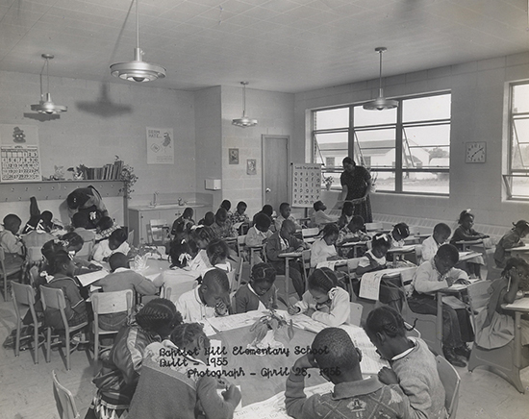
Do Now: Compare and Contrast
Create a comparison chart of these two schools in the 1950s. How equal was the education students were receiving?
Notes:
Image: https://www.nps.gov/nr/twhp/wwwlps/lessons/158equalization/158visual4.htm
Image: https://commons.wikimedia.org/wiki/File:Queensland_State_Archives_1578_Library_Buranda_State_School_c_1950.png

Slide 32
Emmett Till: Question 4
Lesson Three
Tuesday, 29 October 2019

Slide 33
Lesson Objectives
AO3
Compare writers’ ideas and perspectives as well as how these are conveyed across two or more texts
Lesson Outcomes
We will read two sources associated with the case of Emmett Till
We will respond to a Q4 and consider the writer’s perspective
We will examine a model response

Slide 34
What is the difference in funding?
Carolina state spent $179 per student per year educating white children.
Carolina state spent $43 per student per year educating black children.
EXT: Roughly how much more funding (%) do white schools get?
Notes:
$ 136 EXT: 316%
Image: https://www.nps.gov/nr/twhp/wwwlps/lessons/158equalization/158visual4.htm
Image: https://commons.wikimedia.org/wiki/File:Queensland_State_Archives_1578_Library_Buranda_State_School_c_1950.png

Slide 35
Sophisticated Subject Terminology Starter:
Whilst every sentence has a grammatical structure (simple, compound, complex or minor), they also have a function. Below are the four types of sentence function.
Come up with your own example for each and let your partner check if you have correct answers.
Declarative Sentences:
By far the most common type of sentence, we use declarative sentences to convey information or to make statements and end in a full stop.
I can play the piano.
Interrogative Sentences: Interrogative sentences are used in asking questions. They end with a question mark.
Can you play the piano?
You play the piano, don’t you?
Imperative Sentences:
Imperative sentences are used in issuing orders or directives.
Stop playing the piano.
Exclamative Sentences:
Exclamative sentences are used to make exclamations. They end with an exclamation mark.
I hate the piano!

Slide 36
Question Four
Copy out the question. Highlight and annotate the key words. What is the question actually asking you to do?
Try to identify how the writers have used language and structure to show subtle differences in their attitudes. This will show the examiner that you’ve really understood the text.
This part of the question will change depending on the topics covered in the texts.
For this question, you need to refer to the whole of Source A, together with the whole of Source B.
Compare how the writers convey their different attitudes and perspectives of the events that they describe.
In your answer, you could:
compare their different attitudes and perspectives
compare the methods they use to convey their attitudes and perspectives
support your response with references to both texts.
[16 marks]
Make sure you cover everything mentioned in the bullet points – you need to write about what the writers’ attitudes are and how they are similar or different (depending on the wording of the question).
Make sure you give quotations and examples from both sources.

Slide 37
Differences
Source A was written in 1955 and published by the St. Louis Argus newspaper, a small African-American newspaper published in Chicago. It was written at a time of severe segregation between blacks and whites and racial tension was high. This was written weeks after the discovery of Till’s body – before the trial and when people were campaigning for the prosecution of the brothers.
All of these things would influence the writer’s viewpoint/perspective/ideas/opinions/attitudes. Question Four is about identifying and proving those differences.
Source B was written in 2017 and published by the Guardian, a well funded, widely distributed liberal national newspaper - over sixty years later - after the trial, after the men’s release, after the civil rights movement, after Martin Luther King, after Rosa Parks, after the USA’s first black President. This would give the writer some perspective and influence their opinion.

Slide 38
Peer Assess and then finish my answer
Both texts agree that the crime was an appalling and evil murder and one of significant importance. However they present this information in different ways.
Firstly, Source A attempts to remain objective by using predominantly declarative sentences to report on the “kidnapping” and “murder”. There are not many adjectives that give away the writer’s opinion on the matter. However, the writer shows their attitude through subtle methods – they primarily include quotations from other African Americans (namely Till’s family) which alters the tone of the text. The extensive emotive language used when we discover that the body “wasn’t even embalmed” or that he had his mother on his “mind when [he] died” shows that the writer clearly found the lynching of this youth a particularly upsetting tragedy. The writer has attempted to display their emotions and attitudes towards the crime by allowing the raw, emotion inducing effect of statements such as “murdering children” to affect the reader and let the writer’s feelings be passively displayed.
Conversely, in Source B, the writer has over sixty years of social progress to provide perspective and assist them in expressing their own, personal opinion. It is for that reason that we begin to see adjectives such as “ghastly” that show the writer’s opinion coming through. Different to Source A, the modern text chooses to report statements exclusively from the white defendants in the case. This use of dialogue to give a voice to the “acquitted”, allows them to share their “tender sorrow” for the Till family in a simple sentence with no further elaboration from the writer. This is an interesting contradiction to Source A as it allows the writer to express their clear disapproving attitude towards the case by almost refusing to comment on the murderer’s statements as they are not worth the writer’s time…

Slide 39
Hint Key
Source B – Repetition of “public”, “admit” and “disappear”
Source B – Admires the impact Till’s death has had
Source A – Semantic Fields – how have they been used?
HINTS
Notes:
Show for low ability sets
Image: https://pixabay.com/en/key-vintage-key-lock-old-antique-2824086/

Slide 40
Question Four Tips
16
Marks
Key Phrase Box
Both writers… whereas…
The writer shows this through…
On the other hand, …
Despite this, …
The writer of Source A’s attitude is made clear when…
Conversely, …
Unlike in Source B when…
Whereas…
“In the exam you are likely to be asked to analyse different views but don’t ignore similarities. One of the signs of a high-scoring answer is that it analyses subtle and detailed differences among some similarities. So, for example, you might say that both writers are nervous but explain the different reasons why they are nervous.” – AQA, 2016
Time | Task | Song
5 Minutes | Find quotations, annotate the techniques and how they link to the question | Joe Cocker - With A Little Help From My Friends
6 Minutes | Paragraph One | Rolling Stones - You Can't Always Get What You Want
6 Minutes | Paragraph Two | Guns N' Roses - Patience
6 Minutes | Paragraph Three | Queen - Bohemian Rhapsody
Point
Quote
Explain
Analyse
Develop
Point
Quote
Explain
Analyse
Develop
Connective
x3
Notes:
https://www.youtube.com/watch?v=nCrlyX6XbTU – With A Little Help From My Friends
https://www.youtube.com/watch?v=PkGrkNu6mDg - You Can't Always Get What You Want
https://www.youtube.com/watch?v=ErvgV4P6Fzc&index=2&list=PLmg3zV92tOh6ZEeyDIcPzp9Sbb2_DMs4s – Patience
https://www.youtube.com/watch?v=fJ9rUzIMcZQ&index=1&list=PLqDzNilwDj_dm_BOGxoCRmvA6CheRwAiw – Bohemian Rhapsody

Slide 41
Self Assessment – Q4
Level Four
Your answer is perceptive and detailed.
Level Three
Your answer is clear. You know your stuff!
Level Two
You’re still not quite sure yet. You have the basics, but it’s not 100% clear.
Level One
Your answer is quite simple and lacking in detail.
What are your strengths?
How could your answer be developed?
Compare the ideas and perspectives of each text in a clear and detailed manner
Prove that you clearly understand the ideas and perspectives in each text.
Use a range of well-selected quotations from each text.
Clearly explore what techniques the writers have used and how they have been used.

Slide 42
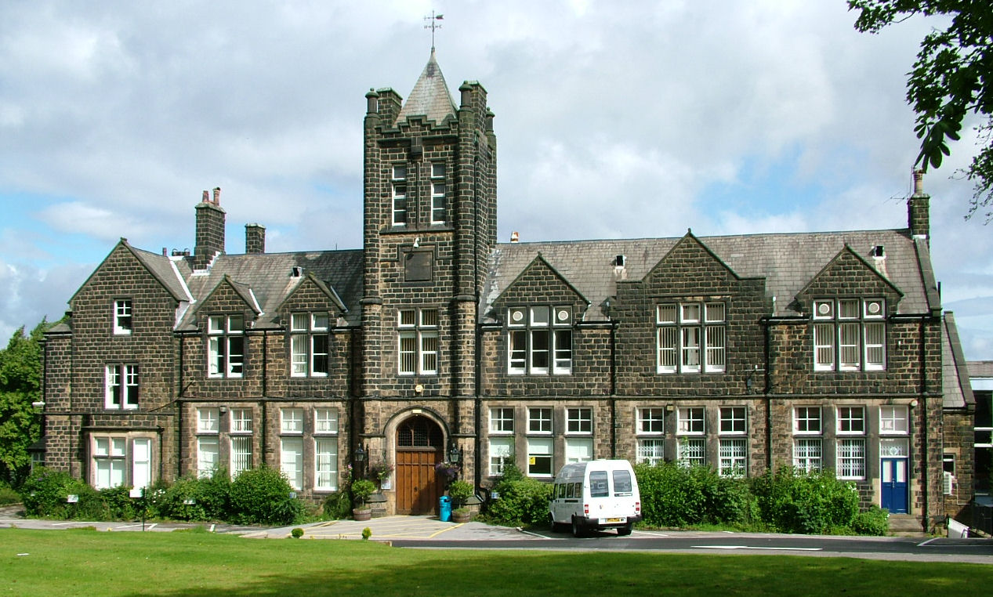
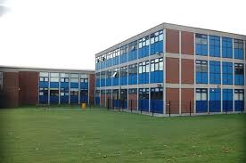
Plenary: Critical Thinking
In Britain, there are grammar schools and comprehensive schools.
Do you think this is an example of the idea ‘separate but equal’?
Do you think pupils in these two types of schools feel equal? Why or why not?
Notes:
Image: https://commons.wikimedia.org/wiki/File:Ilkley_Grammar_School_main_building.jpg
Image: http://www.geograph.org.uk/photo/1009051

Slide 43
Do Now:
With your partner:
What do you know about oppression?
Your discussion may surround real life or movies/books you’ve come across.
Notes:
Image: https://commons.wikimedia.org/wiki/File:Malala_Yousafzai_at_Girl_Summit_2014.jpg
Image: https://pixabay.com/en/non-violence-peace-transformation-1160133/

Slide 44
Emmett Till: Question 3
Lesson Four
Tuesday, 29 October 2019

Slide 45
Lesson Objectives
AO2
Explain, comment on and analyse how writers use language and structure to achieve effects and influence readers, using relevant subject terminology to support their views
Lesson Outcomes
We will read two sources associated with the case of Emmett Till
To improve our range of subject terminology
We will complete a full response to a Q3

Slide 46
Sophisticated Subject Terminology Starter:
Link the sentence type with the correct example and purpose.
Above the sleepy town, where the clouds crawled across the horizon and the minutes trickled by, the sky was grey and sombre.
Can be used to do things like expand on an initial statement, creating more detailed and interesting descriptions.
Simple sentence
Compound sentence
Can be used to build tension or to create a worried and confused tone.
The sky was grey and sombre, and the rain lashed at our faces.
Complex sentence
The sky was growing darker. I couldn’t see where I was going. I stumbled.
Can be used to add description or to give the impression of time dragging.

Slide 47
Word Types
Identify the nouns, verbs, adjectives and adverbs in this text:
“Cybercriminals do stuff online, so punish them by taking away their internet access. It’s as simple as taking a crowbar from a burglar. Or is it? Some outside-the-box thinking by a top cop this week has triggered a debate among cybersecurity types about young offending and punishment.
Ch Supt Gavin Thomas, the president of the Police Superintendents’ Association of England and Wales, suggested in an interview that wifi jammers – devices worn on the ankle or wrist to block the internet – could serve as a smarter punishment for cybercrimes than prison. “We have got to stop using 19th-century punishments to deal with 21st-century crimes,” he said.”
Types of words are used for varying purposes.
Match the word type with the correct definition of purpose.
Words that describe nouns, e.g. pretty, incredible, blue.
Words that are objects or things (can be common or proper) e.g. Alfred, table, nowhere.
Words that describe an action, e.g. run, jumping, read.
Words that describe a doing word, e.g. quickly, excitedly, silently.
Verbs
Adjectives
Nouns
Adverbs
Word Type | Example | Effect
Noun | “Cybercriminals” | Introduces us to who the article is about – emotive word which makes us dislike them.
Verb
Adjective
Adverb

Slide 48
Anecdote
You will find these in travel writing, diary or journal accounts, reviews…
An anecdote is a short, personal story of the writer used to entertain, amuse or warn the reader.
What is the effect of the anecdote in this passage? Discuss with your partner.
Before Christmas I took a young relative to a jazz concert. The thought of it ruined his whole day. He scuffed around the house like an angry rhino. After the event, even he acknowledged that we had a good time. But neither of us would ever get back the dreadful hours that preceded it. He’d fallen prey to a cardinal paradox – poisoning the present by worrying about something that might happen in the future.
We’ve all done that. The homo sapiens is so clever, and yet sometimes so stupid with it. We are the only species that can get wrapped up in things that haven’t yet happened or things that are long gone but can never be changed.

Slide 49
Challenge Homework: Due Friday
One side of A4 analysis of this piece of text:
“Naturally, the black cat sat quietly on the warm, red mat.”
You may discuss connotations, but I want you to expand your use of subject terminology; therefore, you will be marked on your use of subject terminology only.
Areas for discussion:
Word class
Clause types
Sentence type
Sentence function
Word order
Tense
Person/perspective
Punctuation
Post/pre modifiers
Noun/verb phrases
You may need to research some of these areas of discussion; however, learning them will help you greatly in the exam.

Slide 50
Video
In 1968, after being disgusted with the way people were treated due to race, a teacher named Jane Elliott carried out a experiment in discrimination based on the eye colour of children in her class:
Day 1 – Blue eyed people are superior.
Day 2 – Brown eyed people are superior.
Day 3 – Review.
As we watch…
a) What do you find shocking about this film?
b) Why is it important to target education when looking for reform?
Notes:
Click the header, or: https://www.youtube.com/watch?v=KHxFuO2Nk-0
Can watch the whole thing. Or can just watch the first 3 and a half minutes. Then skip to 11:40

Slide 51
Question Three
You are going to attempt a full Q3. This means 3 minutes of annotation and 12 minutes of writing.
Copy out the question. Highlight and annotate the key words. What is the question actually asking you to do?
You now need to refer only to Source B from lines 1 to 35.
How does the writer use language to present the crime?
[12 marks]

Slide 52
Question Three Tips
Key Phrase Box
At first…
Making it seem…
Encouraging the reader to…
In total contrast to this…
This is built on when…
This connotes…
We sense…
When the writer describes…
which expresses…
“A common mistake that students can make is to focus too much on effective words and phrases and ignore other relevant features. When you plan your answer to this question, make sure you analyse sentence forms, language features and punctuation as well” – AQA, 2016
12
Marks
Time | Task | Song
3 Minutes | Find quotations, annotate the techniques and how they link to the question | Radioactive – Imagine Dragons
4 Minutes | Paragraph One | Can’t Stop The Feeling – Justin Timberlake
4 Minutes | Paragraph Two | Things We Lost In The Fire - Bastille
4 Minutes | Paragraph Three | Pumped Up Kicks – Foster The People
Technique
Quote
Explain
Develop
x3
(Develop = Level 4)
Notes:
https://www.youtube.com/watch?v=4U8C_XuE7wc Radioactive
https://www.youtube.com/watch?v=_KAZX8i_RPQ Can’t Stop The Feeling
https://www.youtube.com/watch?v=dYRqIAuY9IQ Things We Lost In The Fire
https://www.youtube.com/watch?v=SDTZ7iX4vTQ Pumped Up Kicks

Slide 53
Hint Key
Can you find a semantic field?
Repetition of certain words or phrases.
Use of dialogue (speech).
Use of simple sentences.
Adjectives (“ghastly”)
Verb phrases (“changed the United States”)
HINTS
Notes:
Show for low ability sets
Image: https://pixabay.com/en/key-vintage-key-lock-old-antique-2824086/

Slide 54
Plenary – Self Assessment – Q3
Level Four
Your answer is perceptive and detailed.
Level Three
Your answer is clear. You know your stuff!
Level Two
You’re still not quite sure yet. You have the basics, but it’s not 100% clear.
Level One
Your answer is quite simple and lacking in detail.
What are your strengths?
How could your answer be developed?
Clearly and accurately identify the names of the techniques
Use a range of appropriate quotations
Explore the different effects of the writer’s language techniques

Slide 55
Extension Task:
A semantic field is a group of words with a similar theme or idea behind them.
Writers may use a series of words within one semantic field in order to make you understand an opinion on a certain event or feel a certain way about something.
You must also state a semantic field of… a certain topic. For the lists of words below, decide what they are a semantic field of.
Write a diary account of a time when you were really saddened about something. Use a semantic field (related words about excitement, or something else) to emphasise a particular element of your experience.
Stunning
Glorious
Iridescent
Pretty
Idyllic
Bullets
Guns
Wound
Trench
Enemy
Eye popping
Trembling
Scream
Phobia
Nerves

